Slide 1
Reading observations in Sweden
Getting In Touch With Literacy 2023
Maria Ellingsson maria.ellingsson@spsm.se
Resource Center Vision
National Agency for Special Education and Schools, Sweden
Objective 1: Orientation in different reading skills that are important to braille readers.
Objective 2: Success factors and challenges in developing reading skills for braille reading students.
Objective 3: Organizing braille teaching in a mainstream school setting where the majority are print readers.

Slide 2
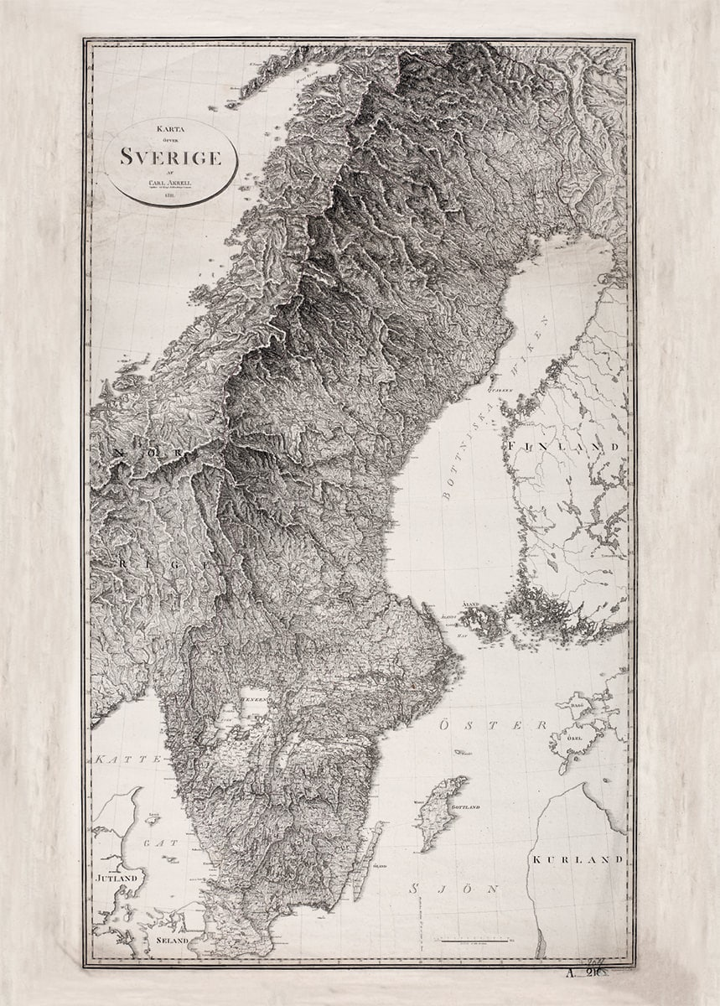
Sweden – a small yet large country
Population density: Sweden ⬄ Minnesota
Population 10.000.000
General education since 1867
Tax financiation of all education, including school lunches
9 year => 10 year long mandatory school

Slide 3
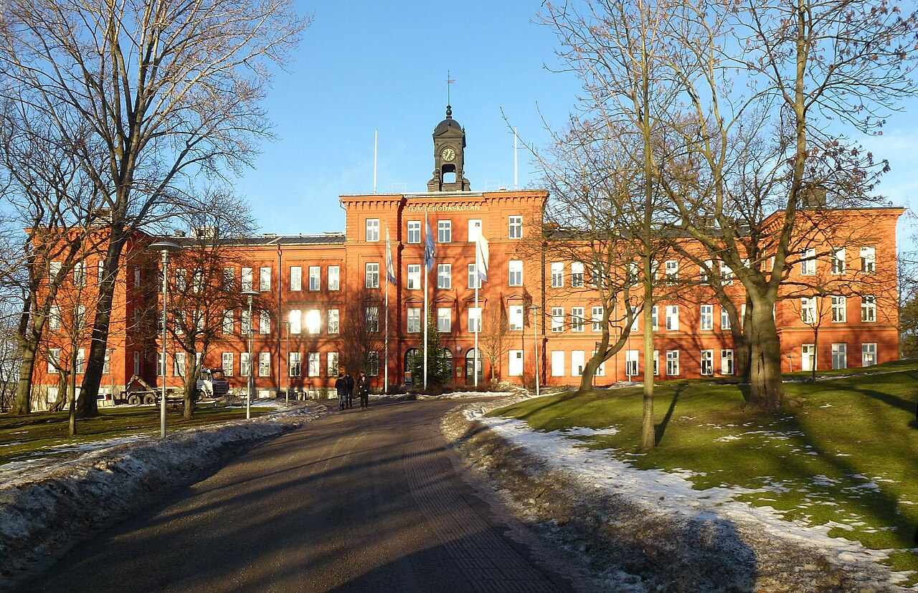
Braille education – a brief historic glance
A diverse group
<10 students per school year
Special school until 1987: Tomtebodaskolan
Ambition of creating education for braille reading students in local schools
Inclusive education
Increased social participation
Equal, adapted and available education in braille and other subjects
Support from Resource center vision
Today – special school for MDVI students but the majority attend mainstream schools
Photo: Holger Ellgaard

Slide 4
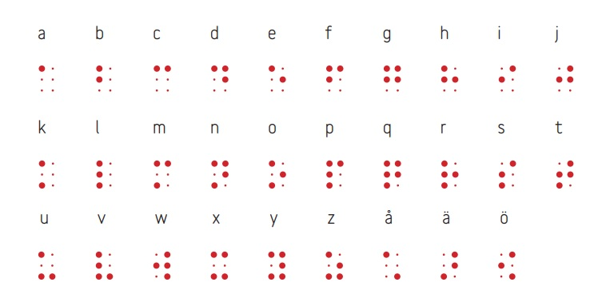
Braille in Sweden
Uncontracted Braille
Short experience with Braille in schools (de Verdier & Ek, 2014)
29 letter alphabet
Braille in wide spacing in early years

Slide 5
Educating teachers
Courses for school staff in various grades and subjects
Focus
Creating an accessible learning environment
Teaching of Braille reading
Mainly digitally based with some physical meetings

Slide 6
Organizing inclusive education in a mainstream school environment
Recommended: Dual teacher system with support and close contact with special education team (Whitburn, 2014)
Reality
Dual teacher system
Class teacher + Designated resource teacher or resource person with relevant education
Younger pupils – older students
Classroom teacher => Subject teachers
Resource teacher => Resource person or educational assistant

Slide 7
The purpose of reading observations
Following the individual student’s reading development
Trends on a group level
Increasing knowledge
Supporting school personnel and thereby students
Recommending interventions and training methods

Slide 8
Reading Observations Today
Letters
Numbers
Words
Brief texts in rising difficulty
Texts adapted to age and/or ability (Veispak et al., 2012)
Screening tools
Examples of words:
al is sa ol sal los
sor mol sil ram vor vas
nol rov nusa mamma lusa
fel rita solar kul lika
trad groda bjorn flyger

Slide 9
Routine from grade 2
Text reading
Screening test
Reading comprehension
Reading talk in general
Participation from teacher

Slide 10
Elements of reading Braille
Decoding
Confusion; accuracy
Reading speed
Finger and hand use – strategies
Line change technique; backing up, diagonal movement or scissors technique
Rubbing and regressions
Sounding => automated reading
Reading comprehension
Interest and attitudes towards reading
(Millar, 1997; Swenson, 2015; Wall Emerson et al., 2009a; Rex et al., 1984)
Advise to schools
For knowledge to the home

Slide 11
The big picture The chart is based on students who have undergone reading observations from the academic year 2011/2012 through 2022/2023. The number of students the chart is based on varies among different grade levels depending on the number of participants each year. The chart is based on students who have followed the regular text selection for their respective grade level.
Grade | Number of students | Median wpm
2 | 34 | 25
3 | 43 | 36
4 | 53 | 40
5 | 45 | 47
6 | 28 | 63
7 | 31 | 51
8 | 19 | 42
9 | 13 | 42

Slide 12
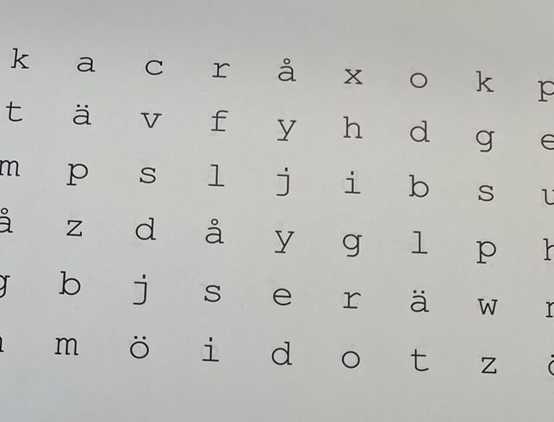
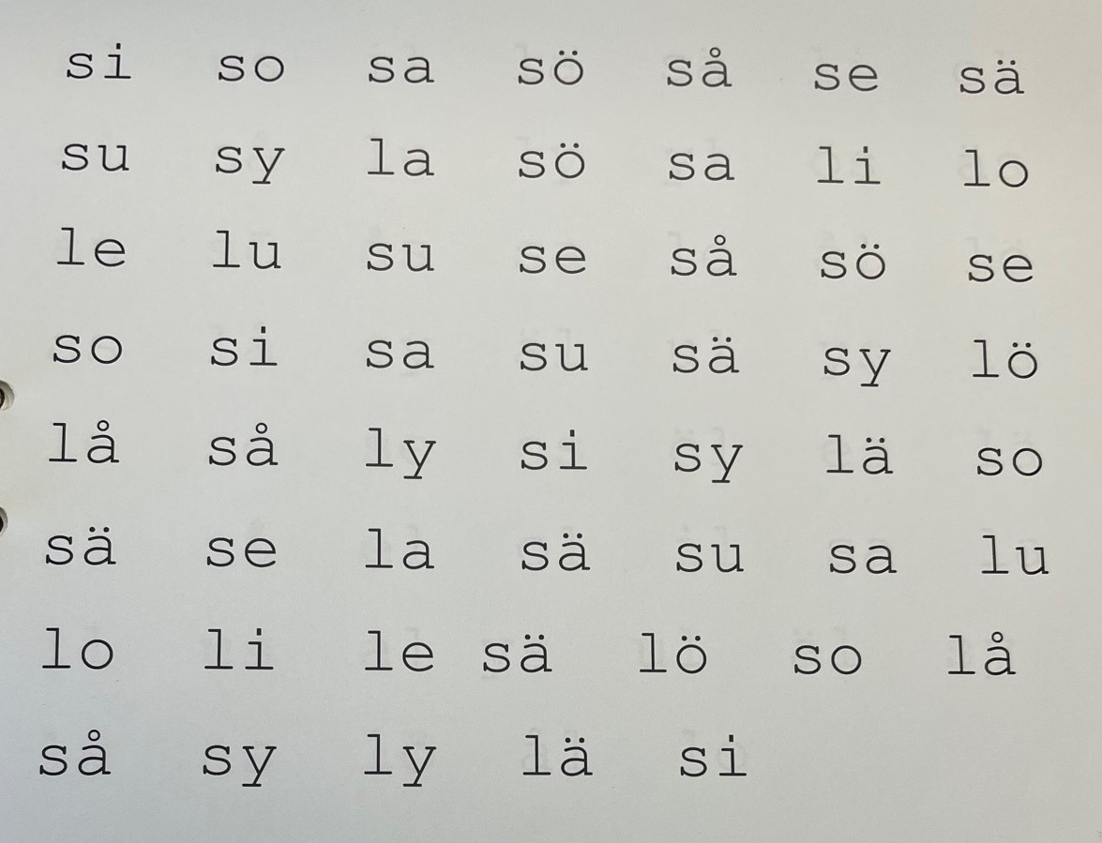
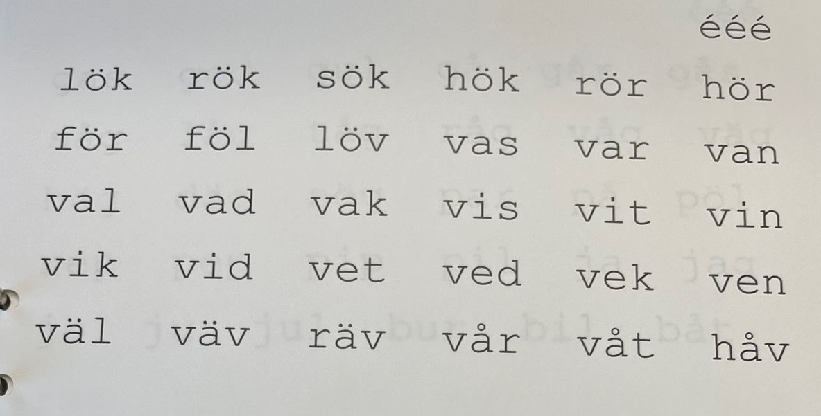
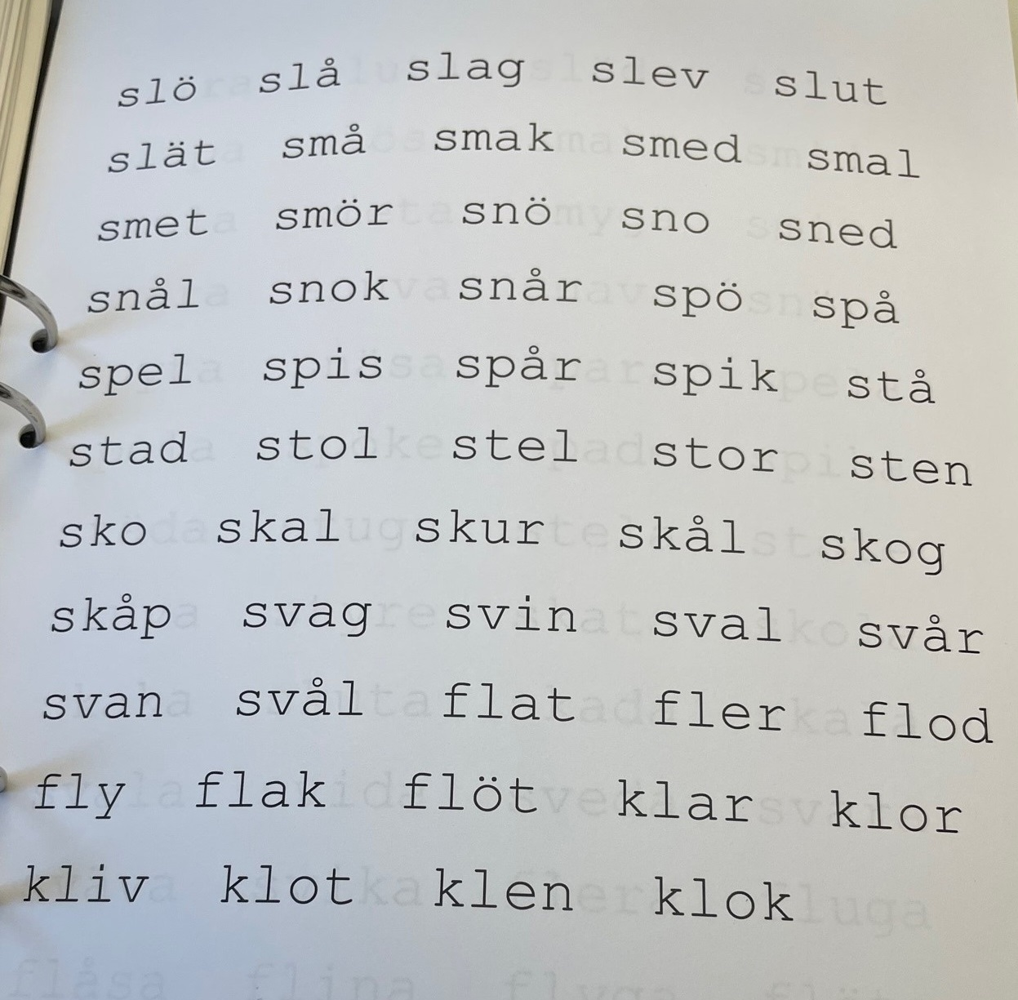
Common advise (1)
Decoding training
Rydaholm method (pictures on the right)
Repeated reading
Individual material. Training difficult words or letters that are often confused
(Foulke, 1982; Nolan & Kederis, 1969; Stanfa & Johnson, 2017; Swenson, 2015; Wolff, 2011)
Lots of braille
Making text available
Reading on Braille display
(Fellenius, 1999)
Reading comprehension (Rex et al., 1994)

Slide 13
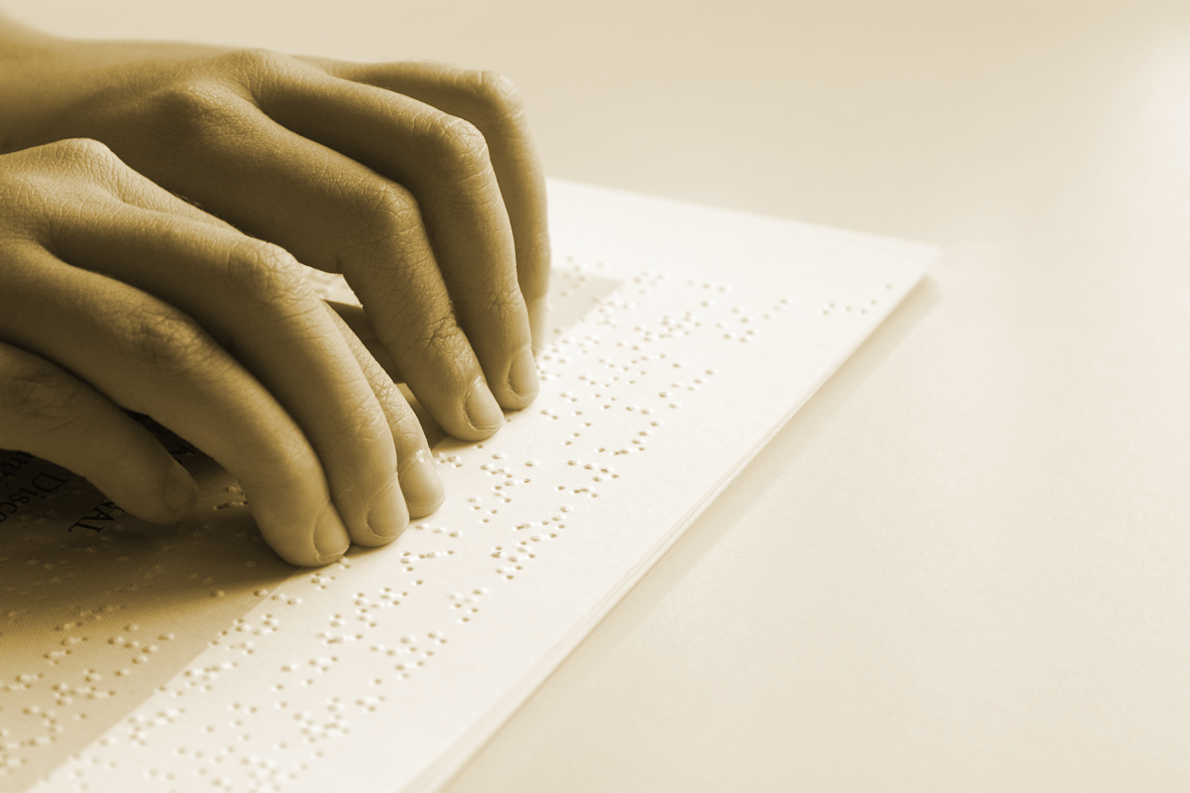
Common advise (2)
Reading technique
Using both hands, activating passive hand, working towards scissors technique,
Start on narrow spacing, work on endurance
Study technique on Braille display
”Shadow reading”
(Foulke, 1982; Kusajima 1974; Millar, 1997, best practice)
Structured, frequent training
(Koenig & Holbrook, 2000; Wall Emerson et.al, 2009b)

Slide 14
Reception at schools
Desired support
Reassurance
Information
Interaction
Advantages and disadvantages in shift towards digital meetings
Effects
Interviews provided different information
Higher response rate
Softer values
Openness about challenges

Slide 15
Voices from the real world (of other stuff than digits and statistics)
Erik, 9 years old, grade level 3 (with special ed-teacher Hanna)
Abdi, 10 years old, grade level 4 (with paraprofessional Johnny)
Melissa, 13 years old, grade level 7 (with resource teacher Nadja)

Slide 16
Erik, grade 1-3
Grade level 1
28 letters out of 29, all digits
Confused i/e, h/j
Automated reading
Grade level 2 and 3 Reading speed 76 wpm => 90 wpm
Right index finger, sometimes left index finger => Right and left index fingers active
No rubbing, no regressions
Left hand finds next line, waits for right hand => Both hands diagonal movement to next line
Excellent reading comprehension
Advise
Column training
Rydaholm
Training scissors technique
Encourage student to take on challenges in reading
Working with Erik:
Class teacher
Educational assistant
Special education teacher, Hanna

Slide 17
What are your experiences, Hanna?
"Erik thinks it's great fun. He can get a bit more excited. But it's the same when I do Rydaholm with him; it's the best lesson of the day."
”Taking the advanced reading technique outside my classroom has been challenging. In the beginning, we did exercises with spaces where he had to divide his hands. He found it challenging to use it in other texts. But now the hand follows in a completely different way.”
What effects have you seen?
"He is definitely faster. When we test comprehension, he covers much more than before. Overview reading can be challenging. It takes longer for Erik to go back, find the keywords, and then return to where he was. But he's progressing just like the others."

Slide 18
What is it like teaching a a way of reading and writing that you don’t fully master?
”Well, I mean Braille; I can't read a single letter.
But it has gone very well anyway because the teacher and educational assistant have learned it.
Erik is not overly fond of reading books, but he does it. During silent reading, he reads his book. But at home, he probably listens more.”
Hanna, Special education teacher for Erik

Slide 19
Erik, grade level 4, nov 2023
Text reading Reading speed 90 words per minute
Right index finger, more fingers active Left hand keeping track of lines
Some regressions
Both hands active on Braille display
Working with Erik:
Class teacher, employed in August.
Paraprofessional, 21 years old, just replaced
No previous experience with Braille.

Slide 20
Abdi

Slide 21
Abdi – Reading observation grade 1 and 4
Grade 1
29 letters out of 29, all digits
Lots of rubbing, many regressions
Sounded out words
3/5 texts
Text 3:
Emil and Mia plays.
It is spring and the sun is shining.
Mia said let us play a game.
Emil said we can be in the grass. Then we can take out a blanket. We can play with our cars and boats on the blanket.
Grade 4
Reading speed 30 wpm
Right hand only
Slanting down to next line
No rubbing
Many regressions
Sounds out new words
Struggles with reading comprehension (2/5)
Recommendations:
Encourage Abdi to ask about unfamiliar words.
Repeated reading.
Practice column exercises to engage the left hand.
Encourage to activate his left hand during line breaks.
Consider using the Rydaholm method.

Slide 22
How do you feel about this kind of support?
"I think it's good to see if we're doing things right or if we need to rethink. I don’t think all your texts are great though. There are so many abstract words, like gnomes. He’s from another country, it becomes tricky.“
Which recommendations have you used?
"We do repeat reading every week. Fluency increases. Both conceptual understanding and reading comprehension have improved. He reads really fast, even new text. I'm not worried.“
How has Abdi experienced the training?
"Abdi sighs and puffs. He doesn't like reading with his left hand. Repeat reading becomes easier and easier though. He's not that fast, but there are many who are worse than him."
Johnny, resource person for Abdi

Slide 23
Melissa – looking back
Implemented recommendations
Daily training
The method of Rydaholm
Text talks
Reading homework
Braille in all subjects
Repeated reading
Column exercises
Practise of high frequency words

Slide 24
How have you used the recommendations and which results have you seen?
"If Melissa doesn't understand something, she turns to us. This has resulted in an increase in Melissa's vocabulary, and she now reads long, new words more easily. The training has also resulted in Melissa reading very accurately; she knows to pause at commas and make a brief pause at periods. Melissa also feels that she has developed in all these aspects. The goal is not only for Melissa to read faster but also to understand what she reads. We, therefore, actively work on retelling, which yields good results.”
How do you think that Melissa feels about the training?
"We don't have specific training sessions; instead, training can be found in every subject, practically during every lesson. Melissa has not experienced the training as 'tough' because it is always present. Instead, she sees it as part of everyday work. Melissa increasingly notices that she needs less time to read different types of texts."

Slide 25
Transition to grade 7
Recommendations for a smooth transition
Nadja came along
In grade 7, reading speed stable
Continuing on the same path, add:
Repeated reading
Practice high-frequency words in Swedish and English
Column exercises to activate left hand more
School used almost all suggestions

Slide 26
Challenges for these students
Erik: Keeping up reading speed and tecnique over transitions, making room for individual training
Abdi: Reading comprehension, raising expectations
Melissa: Balancing expectations and goals, increasing independence

Slide 27
Success factors
Early, focused training of decoding and technique
(de Verdier & Ek, 2014)
Positive collaboration and good continuity in work teams
Education, knowledge and/or interest and ambition in teaching teams
(Emerson et al., 2009b)
Student’s own prerequisites
(de Verdier & Ek, 2014)

Slide 28
Challenges
Silence from schools
Time and planning
Lack of experience and knowledge in Braille
Individual training throughout shool
Transitions between teaching teams and schools
Difference and balance in expectations
Late onset blindness
What are your experiences? I would appreciate input.
maria.ellingsson@spsm.se

Slide 29
References (1)
de Verdier, K., & Ek, U. (2014). A longitudinal study of reading development, academic achievement, and support in Swedish inclusive education for students with blindness or severe visual impairment. Journal of Visual Impairment & Blindness, 108, (461–472).
Fellenius, K. (1999). Reading Environment at Home and at School of Swedish Students with Visual Impairments. Journal of Visual Impairment & Blindness, April 1999 (211-223).
Foulke, E. Reading Braille. (1982). In W. Schiff & E. Foulke (Ed.), Tactual Perception (168-208). Cambridge University Press
Koenig A. J., Holbrook M. C. (2000). Ensuring high-quality instruction for students in Braille literacy programs. Journal of Visual Impairment & Blindness, 94, 677–694.
Kusajima, T. (1974). Visual reading and braille reading: an experimental investigation of the physiology and psychology of visual and tactual reading. New Your: American Foundation for the Blind.
Millar, S. (1997). Reading by touch. Routledge.
Nolan, C.Y., & Kederis, C.J., (1969). Perceptual factors in braille word recognition. American Foundation for the Blind Research Series, no. 20. New York: American Foundation for the Blind.
Rex, E.J., Koenig, A.J., Wormsley, D.P., Baker, R.L. (1984). Foundations of Braille Literacy. American Foundation for the Blind.

Slide 30
References (2)
Stanfa, K. & Johnson, N. (2017). Improving reading fluency in braille readers using repeated readings. Journal of Blindness Innovation and Research. 7 (1). from: https://nfb.org/images/nfb/publications/jbir/jbir17/jbir070103.html
Swenson, A. (2015). Beginning with Braille. American Printing House for the Blind.
Topor, Holbrook & Koenig
Wall Emerson, R., Holbrook, C., & D’Andrea, F. (2009a). Acquisition of literacy skills by young children who are blind: Results from the ABC Braille study. Journal of Visual Impairment & Blindness, 103(10), 610 – 624.
Wall Emerson R., Sitar D., Erin J. N., Wormsley D. P., Herlich S. L. (2009b). The effect of consistent structured reading instruction on high and low literacy achievement in young children who are blind. Journal of Visual Impairment & Blindness, 103, 595–609.
Veispak, A., Boets, B., & Ghesquière. (2012). Parallel versus sequential processing in print and braille reading. Research in developmental disabilities, 33, 2153 – 2163. from https://www.academia.edu/18471731/Parallel_versus_sequential_processing_in_print_and_braille_reading
Whitburn, B. (2014).‘A really good teaching strategy’: Secondary students with vision impairment voice their experiences of inclusive teacher pedagogy. British Journal of Visual Impairment 32(2), 148–156.
Wolff, U. (2011). Effects of a randomised reading intervention study: an application of structural equation modelling. Dyslexia: An International Journal of Research and Practice. DOI: 10.1002/dys.438.

